Slide 1
Using CNN to classify dog breeds
Helping animal shelters estimate dog breeds with more confidence

Slide 2
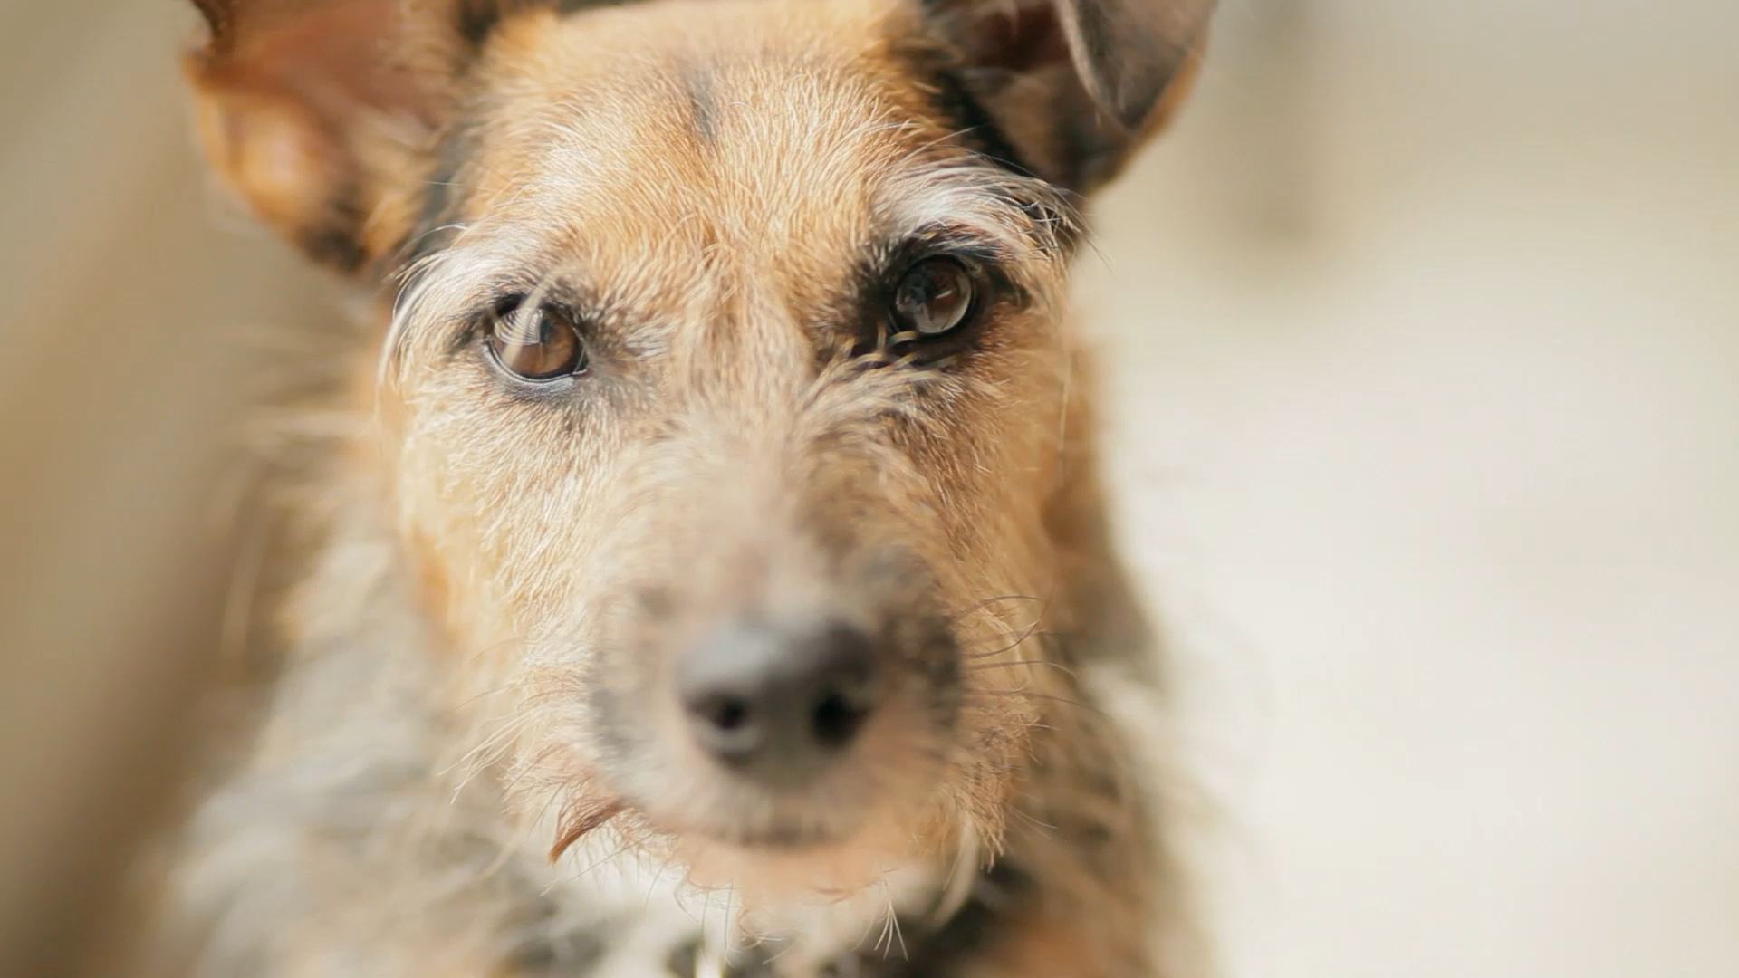
Problem Statement
Approximately 2 million dogs are adopted each in the US each year.
Between 75% - 80% of dogs in shelters are mixed-breed
And as many as 25% of dogs in shelters are purebred dogs
A study found that when trying to identify the primary breed in a mixed-breed dogs, shelter staff got it right 56% of the time. But when they tried to identify the secondary breed, their success rate dropped to 10%.
Correctly identifying breeds can be a matter of life and death at kill shelters. Dogs lacking any Pit Bull DNA were mislabeled as such roughly 50%.

Slide 3
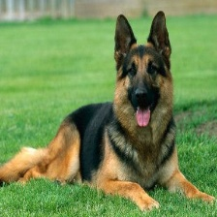
Can CNN Improve classification rates?
Resources at dog shelters are scarce, providing each dog with a DNA test is not feasible. However, I set out to train a model that can improve the classification rates of shelter dogs.

Slide 4
Training and Evaluating the Dog Classifying model
Data
The model – InceptionV3
The Stanford Dog Data – Includes 120 dog breeds from around the work
Transfer learning was used to structure the model.
I fine tuned the model to the dog data and use image augmentation, other regularization techniques
Analysis of single breed predictions
Analysis of mixed breed predictions
Recommendation for next steps
Globally – the model achieved an accuracy scores of 86%
When tested with dogs of two breeds, the model, in its top 10 predictions, the model made at least one match 88% of the time
There is so much room for improvement here, I have a recommendations for next steps

Slide 5
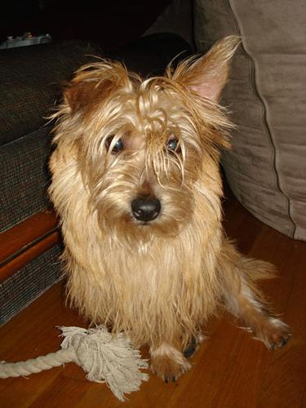
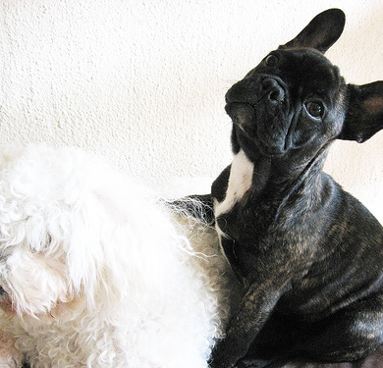
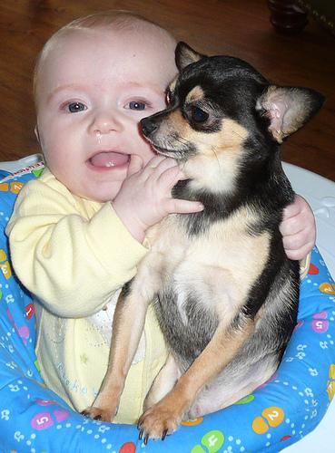
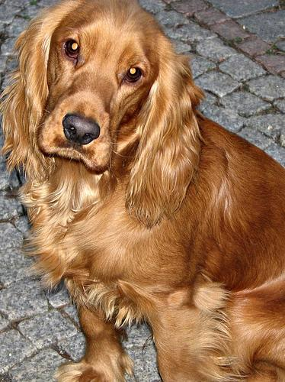
The Data
About 21,500 images in total, relatively balanced. Each breed had at least 150 images and on average, we had about 180 per class.
Cairn
French Bulldog
Chihuahua
Cocker Spaniel

Slide 6
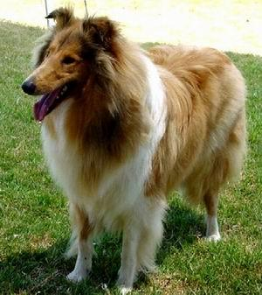
Transfer Learning with InceptionV3
InceptionV3
General Structure
Benefit over other pretrained models is that it’s design to lower the parameter.
Trains relatively quickly
Train in over 21000 images in less than two hours
InceptionV3
Last layer of softmax
Early Stopping
ReduceLROnPlateau which is used to reduce the learning rate once learning stagnates

Slide 7
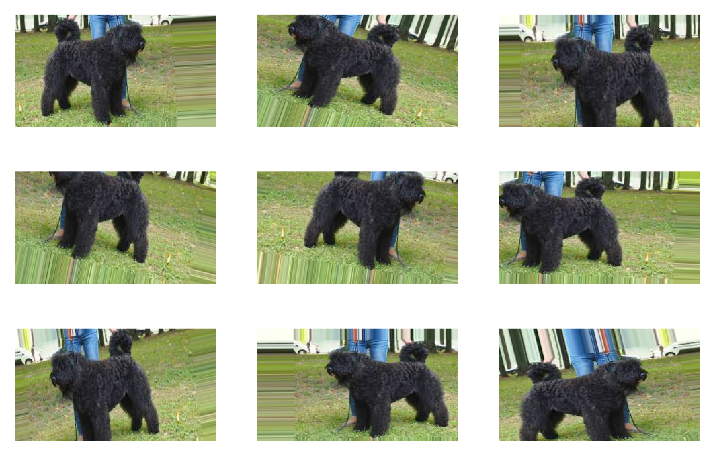
Image Augmentation
Image augmentation was made easy with TF ImageDataGenerator
Flip
Shifts
Shear range
Zoom range

Slide 8
Model Performance – Single breed classification
Globally
Breed by breed
Model enjoyed 86% accuracy score
Over 60% of breeds had recall scores of 0.90 or above
Only 9 breeds had recall scores of less than 0.50

Slide 9
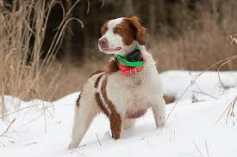
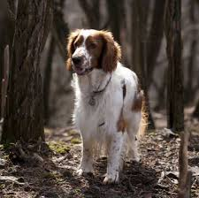
Misclassifications – Too similar
Brittany Spaniel
Welsh Springer Spaniel

Slide 10
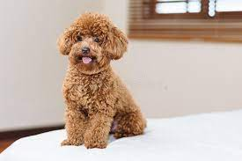
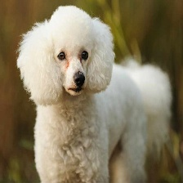
Misclassification – Same breed group
Toy Poodle
Miniature Poodle

Slide 11
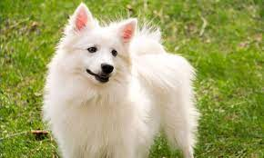
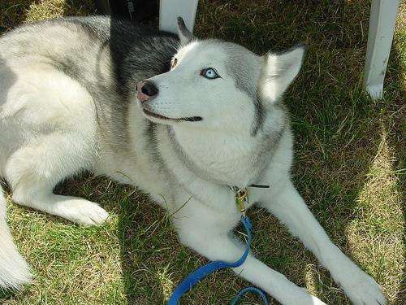
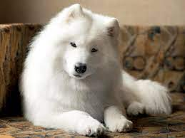
Misclassification – Botched data
Eskimo Dog
Eskimo Dog????!!!
Samoyed

Slide 12
Model Performance – Mixed breed classification
Any Matches
All Matches
Out of the top ten predictions, the model correctly matches at least one of the two breeds 88% of the time.
Out of the top then predictions, the model matches both breeds at a rate of 30%.

Slide 13
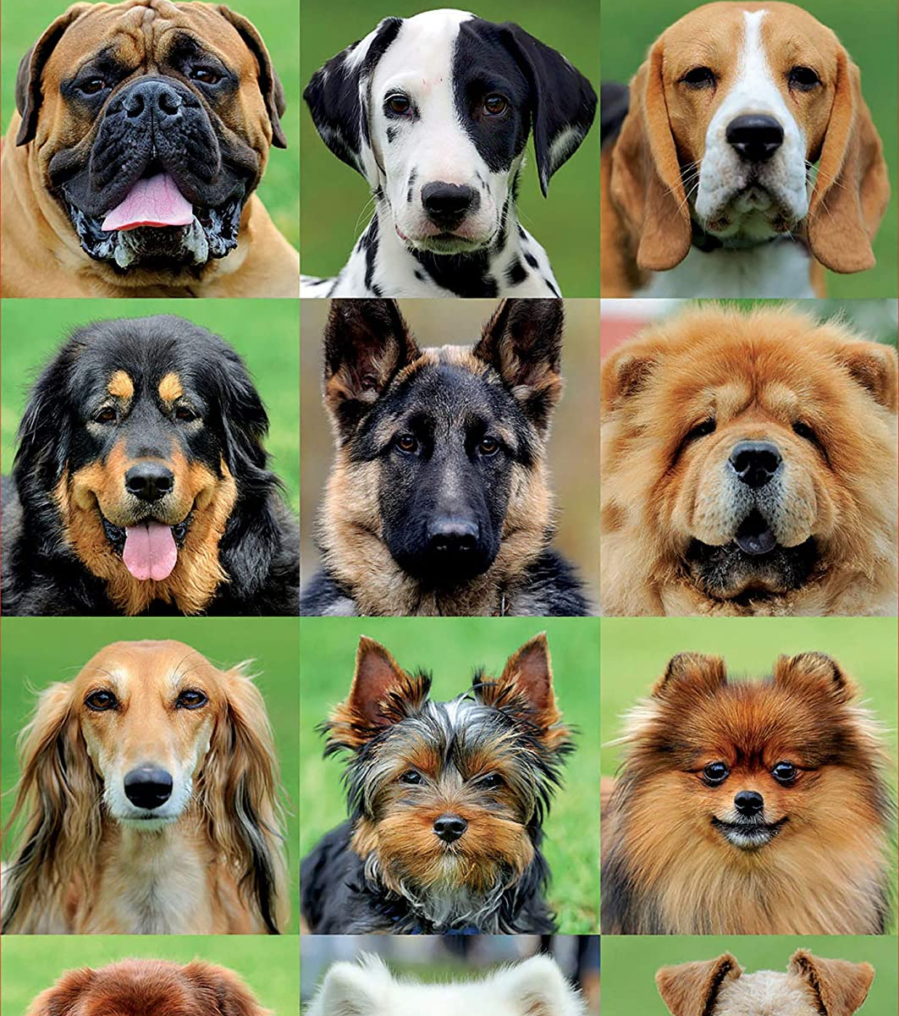
Conclusions
When used as a single breed classifier, the model performs well with an 85% accuracy score, and a global precision score of 86%
Pit Bulls: the model was able to identify bullterriers with precisions scores of 71% or more and can provide more confidence when estimating a breed.
Shelters are not great at classifying mixed breed dogs, and with my model matching at least one breed (in the top ten predictions), 86%, and matching both breeds with approximately 30% rate, I think it can be a useful tool to give shelters a little more confidence when making guesses.

Slide 14
Recommendations for next steps
Improve the data
See if model improves
Do a thorough clean-up of the data. Remove other breeds and make sure only the right breed is included.
Cleaner data should produce better predictions, right?
Get more mixed breed data
Build a proper multilabel model
I want to properly collect data for mixed breeds that is properly confirmed
Mixed breed dogs deserve a real try at predicting their breeds

Slide 15
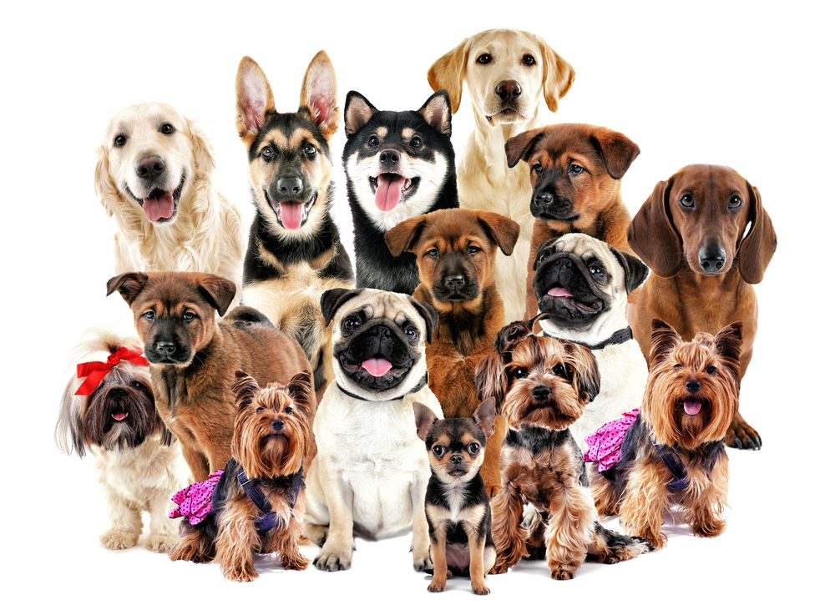
Thank you

